Slide 1
CompSci 116: Lecture 11: Prediction -Classification
Jeff Forbes
April 4, 2019

Slide 2
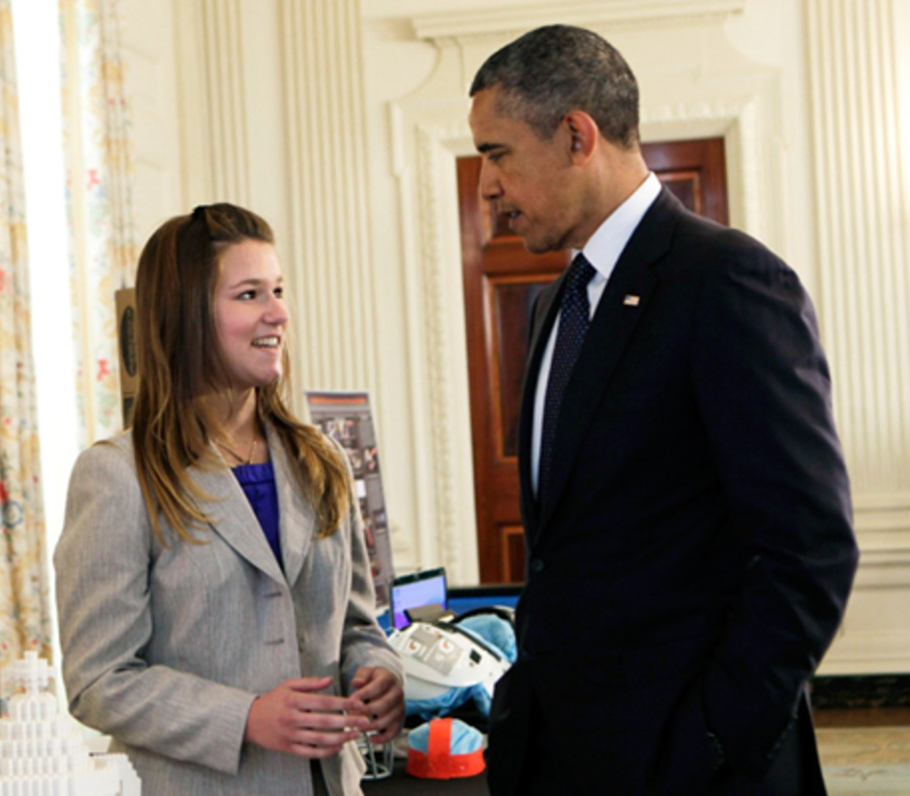
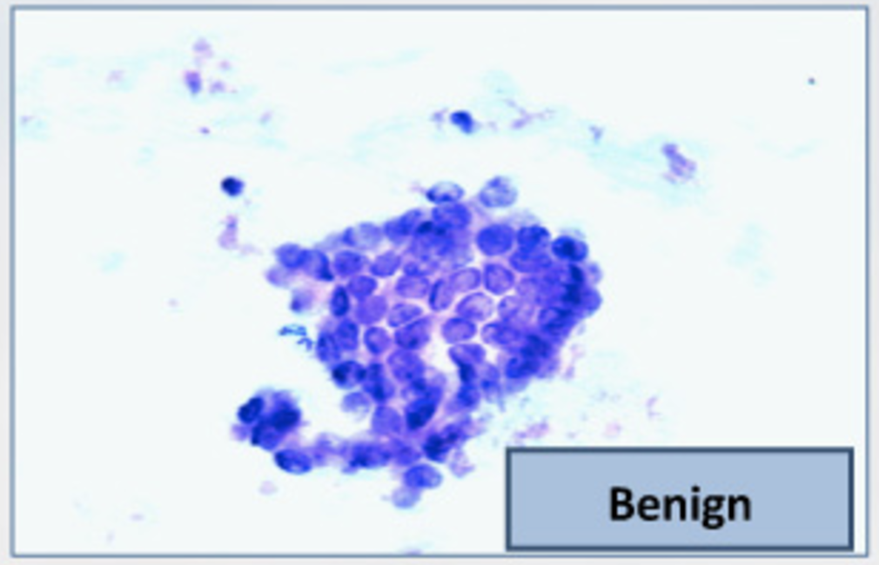
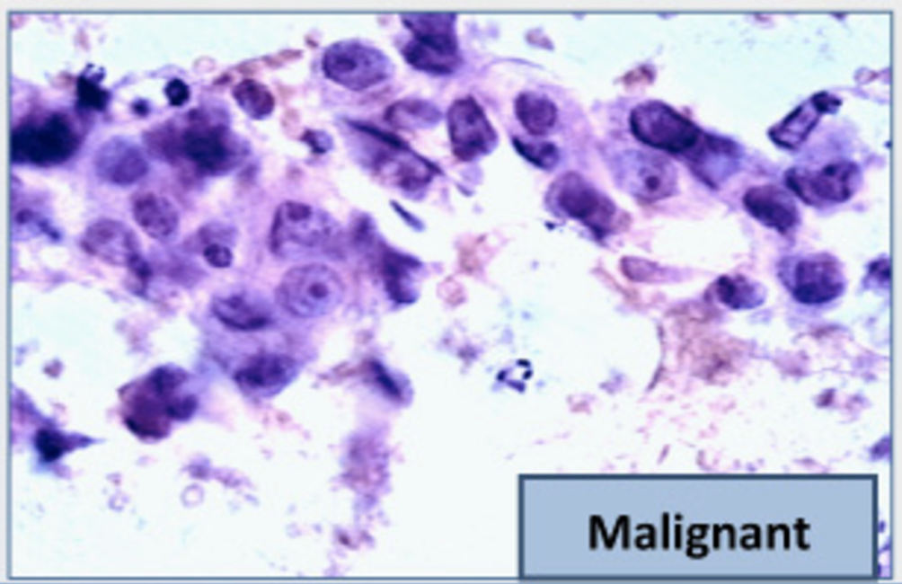
The Google Science Fair
Brittany Wenger, Trinity 2017
Won by 2012 Science Fair building a breast cancer classifier with 99% accuracy
April 22, 2013

Slide 3
Classification Examples
Wenger 2012
(Demo)
Forbes, 1998
Notes:
Fraud: order fraud (Amazon, PayPal, etc.), account fraud (LinkedIn)
Dating: https://www.wired.com/2014/01/how-to-hack-okcupid/
If, through statistical sampling, McKinlay could ascertain which questions mattered to the kind of women he liked, he could construct a new profile that honestly answered those questions and ignored the rest. He could match every woman in LA who might be right for him, and none that weren’t.
Diagnosis: http://www.newyorker.com/magazine/2017/04/03/ai-versus-md
In June, 2015, Thrun’s team began to test what the machine had learned from the master set of images by presenting it with a “validation set”: some fourteen thousand images that had been diagnosed by dermatologists (although not necessarily by biopsy). Could the system correctly classify the images into three diagnostic categories—benign lesions, malignant lesions, and non-cancerous growths? The system got the answer right seventy-two per cent of the time. (The actual output of the algorithm is not “yes” or “no” but a probability that a given lesion belongs to a category of interest.) Two board-certified dermatologists who were tested alongside did worse: they got the answer correct sixty-six per cent of the time.
Personality: https://motherboard.vice.com/en_us/article/how-our-likes-helped-trump-win (Cambridge Analytica—Board member Steve Bannon)
Link personality tests to Facebook profiles
"Followers of Lady Gaga were most probably extroverts, while those who "liked" philosophy tended to be introverts. While each piece of such information is too weak to produce a reliable prediction, when tens, hundreds, or thousands of individual data points are combined, the resulting predictions become really accurate."
"Up to now, explains Nix, election campaigns have been organized based on demographic concepts. "A really ridiculous idea. The idea that all women should receive the same message because of their gender—or all African Americans because of their race." What Nix meant is that while other campaigners so far have relied on demographics, Cambridge Analytica was using psychometrics."
Machine learning to predict recidivism (for parole), to predict whether the bank shoud give you a loan, to predict whether immigrants should be admitted to US. Racism, fairness.

Slide 4
Training a Classifier
Classifier
Attributes of an example
Predicted label of the example
Model the association between attributes & labels
Population
Sample
Labels
Training
Set
Estimate the accuracy of the classifier
Test
Set

Slide 5
Nearest Neighbor Classifier
NN Classifier
Use the label(s) of the most similar training example(s)
Attributes of an example
Predicted label of the example
Population
Sample
Labels
Training
Set
Test
Set

Slide 6
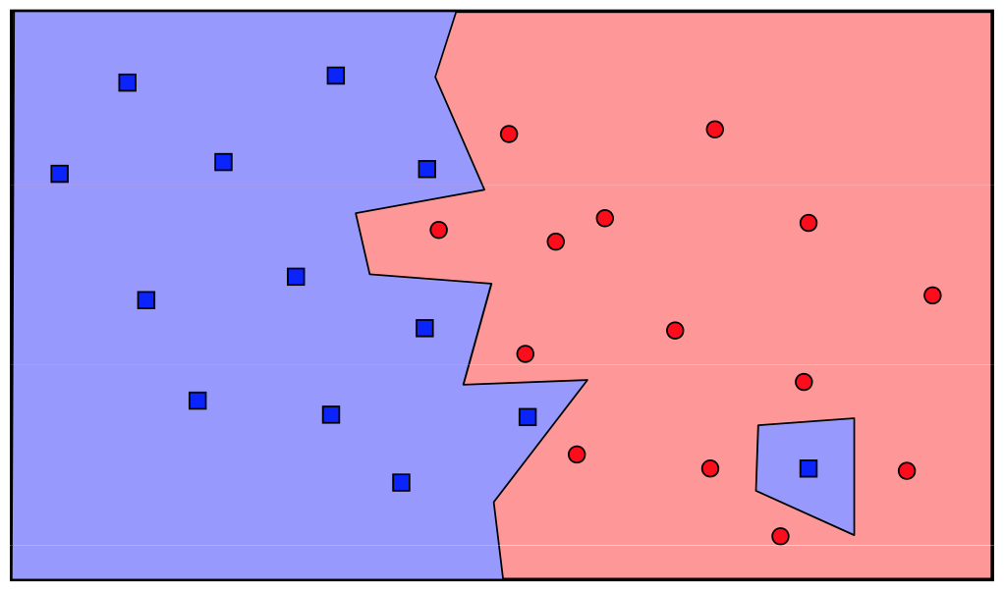
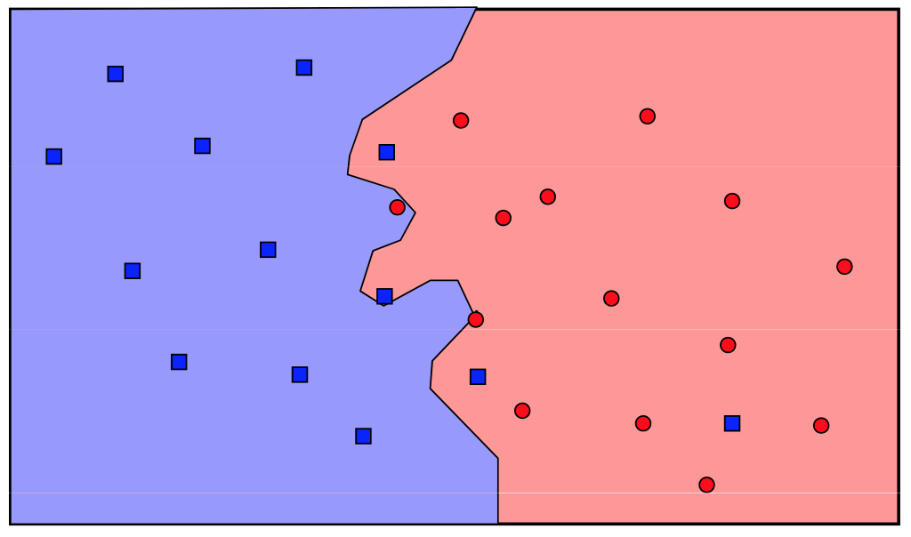
The Classifier
To classify a point:
Find its k nearest neighbors
Take a majority vote of the k nearest neighbors to see which of the two classes appears more often
Assign the point the class that wins the majority vote
1-NN
3-NN

Slide 7
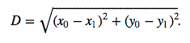
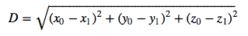
Distance Between Two Points
Two attributes x and y:
Three attributes x, y, and z:
and so on ...
http://bit.ly/FoDS-s19-0404

Slide 8
Finding the k Nearest Neighbors
To find the k nearest neighbors of an example:
Find the distance between the example and each example in the training set
Augment the training data table with a column containing all the distances
Sort the augmented table in increasing order of the distances
Take the top k rows of the sorted table
(Demo)

Slide 9
Rows of Tables
Each row contains all the data for one individual
t.row(i) evaluates to ith row of table t
t.row(i).item(j)is the value of column j in row i
If all values are numbers, then np.array(t.row(i)) evaluates to an array of all the numbers in the row.
To consider each row individually, use for row in t.rows: ... row.item(j) ...
(Demo)

Slide 10
Accuracy of a Classifier
The accuracy of a classifier on a labeled data set is the proportion of examples that are labeled correctly
Need to compare classifier predictions to true labels
If the labeled data set is sampled at random from a population, then we can infer accuracy on that population
Sample
Labels
Training
Set
Test
Set
(Demo)

Slide 11
Regression “Model”: Signal + Noise
Distance drawn at random from normal distribution with mean 0
Another distance drawn independently from the same normal distribution

Slide 12
What We Get to See

Slide 13
Regression Prediction
If the data come from the regression model,
The regression line is close to true line
Given a new value of x, predict y by finding the point on the regression line at that x

Slide 14
Confidence Interval for Prediction
Bootstrap the scatter plot
Get a prediction for y using the regression line that goes through the resampled plot
Repeat the two steps above many times
Draw the empirical histogram of all the predictions.
Get the “middle 95%” interval.
That’s an approximate 95% confidence interval for the predicted value of y.

Slide 15
Predictions at Different Values of x
Since y is correlated with x, the predicted values of y depend on the value of x.
The width of the prediction interval also depends on x.
Typically, intervals are wider for values of x that are further away from the mean of x.

Slide 16
Confidence Interval for True Slope
Bootstrap the scatter plot.
Find the slope of the regression line through the bootstrapped plot.
Repeat.
Draw the empirical histogram of all the generated slopes.
Get the “middle 95%” interval.
That’s an approximate 95% confidence interval for the slope of the true line.

Slide 17



Rain on the Regression Parade
We observed a slope based on our sample of points.
But what if the sample scatter plot got its slope just by chance?
What if the true line is actually FLAT?

Slide 18
Test Whether There Really is a Slope
Null hypothesis: The slope of the true line is 0.
Alternative hypothesis: No, it’s not.
Method:
Construct a bootstrap confidence interval for the true slope.
If the interval doesn’t contain 0, reject the null hypothesis.
If the interval does contain 0, there isn’t enough evidence to reject the null hypothesis.

